Slide 1
Teamwork and Communication
Software Methodologies

Slide 2

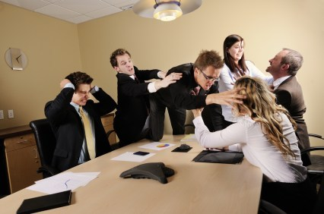
Team Dynamics

Slide 3
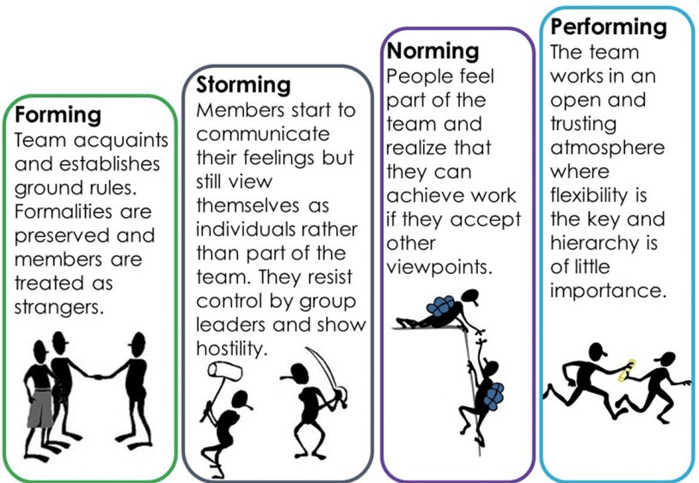
Tuckman’s Model of Team Dynamics
Dr Bruce Tuckman published his Forming Storming Norming Performing model in 1965.
Tuckman's model explains that as a team develops relationships and roles evolve and the leader changes leadership style.

Slide 4
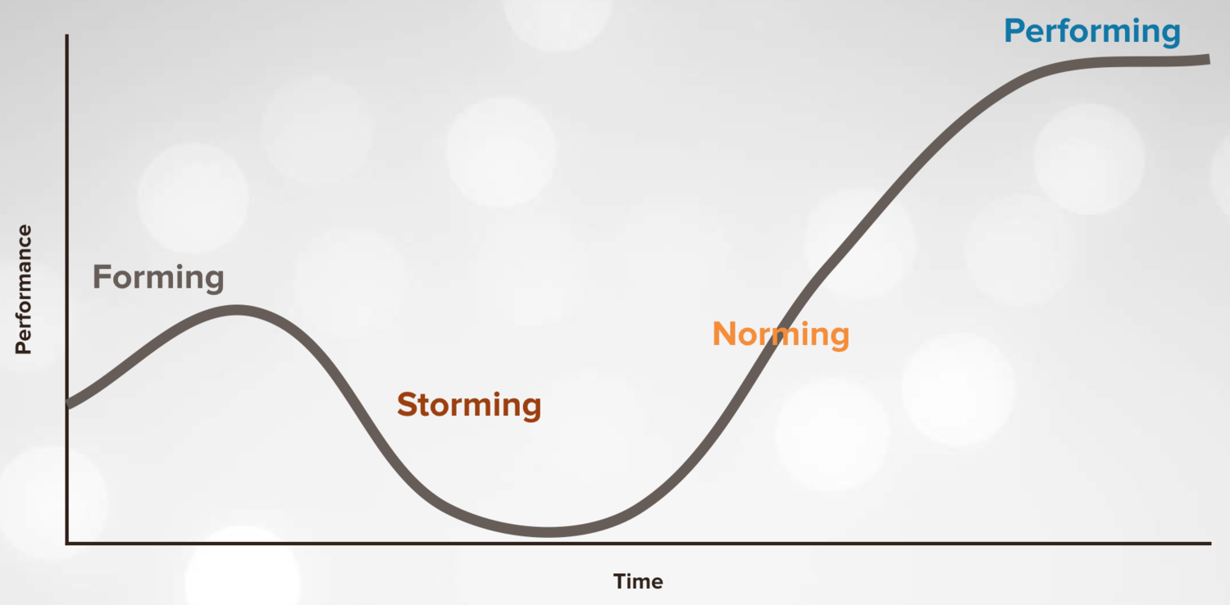
Tuckman’s Model of Team Dynamics
As the performance of the team changes so should the leadership style, beginning with a directing style, moving through coaching, then participating, finishing with delegating and almost detached.

Slide 5
Stage 1: Forming
In this stage, most team members are positive and polite. Some are anxious, as they don’t yet fully understand what work the team will do. Others are simply excited about the task ahead.
This stage can last for some time, as people start to work together, and as they make an effort to get to know their new colleagues.
Some things may help move through this stage faster:
Team building activities
Agree on a team ‘manifesto’ – agree to ‘Disagree and Commit’
Scrum master keeps control of ceremonies to ensure everyone understands how things should be done

Slide 6
Stage 2: Storming
People push against the boundaries established in the forming stage and frustrations start to emerge.
Storming often starts where there is a conflict between team members' natural working styles.
Some people may jockey for position or feel insecure or unhappy with their developing role on team.
Failing teams may never get out of this stage!
Some things may help move through this stage faster:
It’s crucial to clarify the team’s overall goals and individual roles and responsibilities.
The aim is to encourage everyone to recognise that all team members are working to the same goals, and everyone’s contribution is valuable.
The team should understand that storming is normal and necessary, and shows that they care.

Slide 7
Stage 3: Norming
Cohesion and calm begins to emerge as team members become engaged and supportive.
Can include feelings of reconciliation, relief and lowered anxiety.
Now the team members know each other better they feel more able to ask each other for help and give or take constructive feedback.
Some things may help move through this stage faster:
Provide opportunities for group learning and recognise individual and team achievements
Use a ‘team health check’ to identify any remaining issues
Scrum master can take a more hands-off approach and allow the team to become more autonomous.

Slide 8
Stage 4: Performing
The team has a shared vision and is able to stand on its own feet.
Disagreements still occur but now they are resolved within the team positively.
All team members are busy and collaborating to get stories over the line.
Everyone on the team has their voice heard.

Slide 9
Stage 5: Adjourning
In 1975 Tuckman added a fifth stage: Adjourning.
This describes what happens when a well performing team is disbanded.
Team members can be left feeling deflated and insecure about the change.
Strategies for this stage
Recognise and reward the team’s success and individual achievements
Support team members with the transition to their next role

Slide 10

Team Communication

Slide 11
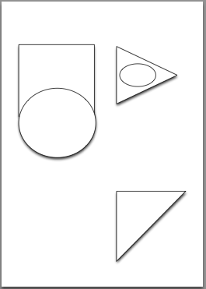
Team Communication
Individually spend 5 minutes coming up with a design using simple geometric shapes.
Use 4 – 5 shapes. Not too simple, not too complex.
Shapes can overlap and areas can be shaded.
Example:

Slide 12
Team Communication
Write your name on the back of your design and fold it in half.
Without looking at your design write down the steps someone would need to follow to reproduce your design.
Your instructions must include words only!
Write your name on the back of your instructions and swap them with another team member.
You now have 5 minutes to reproduce your partner’s design by referring ONLY to the written instructions.
How did you do?

Slide 13
Team Communication
In pairs decide who will be the PO and who will be the developer.
The PO takes someone else’s design and sits back-to-back with the developer.
Only the PO can see the design and only the PO can speak.
You have 5 minutes for the developer to reproduce the design.
How did you do?

Slide 14
Team Communication
Swap roles with your partner and the new PO should take a new design from another pair’s old PO.
Again only the PO can see the design, but this time you can both speak.
You have 5 minutes for the developer to reproduce the design.
How did you do?

